Slide 1
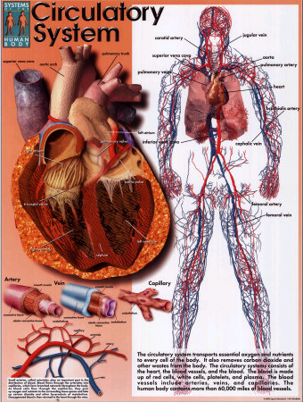
The
Circulatory
System

Slide 2
Objective:
Understand the circulatory system is structured to facilitate the transport of materials through the body

Slide 3
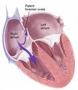
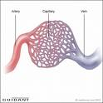
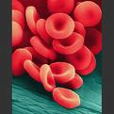
Three Main Parts of the Circulatory System

Slide 4
Three Main Parts of the Circulatory System
The Heart | The Blood Vessels | The Blood
4 chambers: The left atrium The left ventricle The right atrium The right ventricle | Arteries Veins Capillaries | Red blood cells White blood cells Platelets Plasma

Slide 5
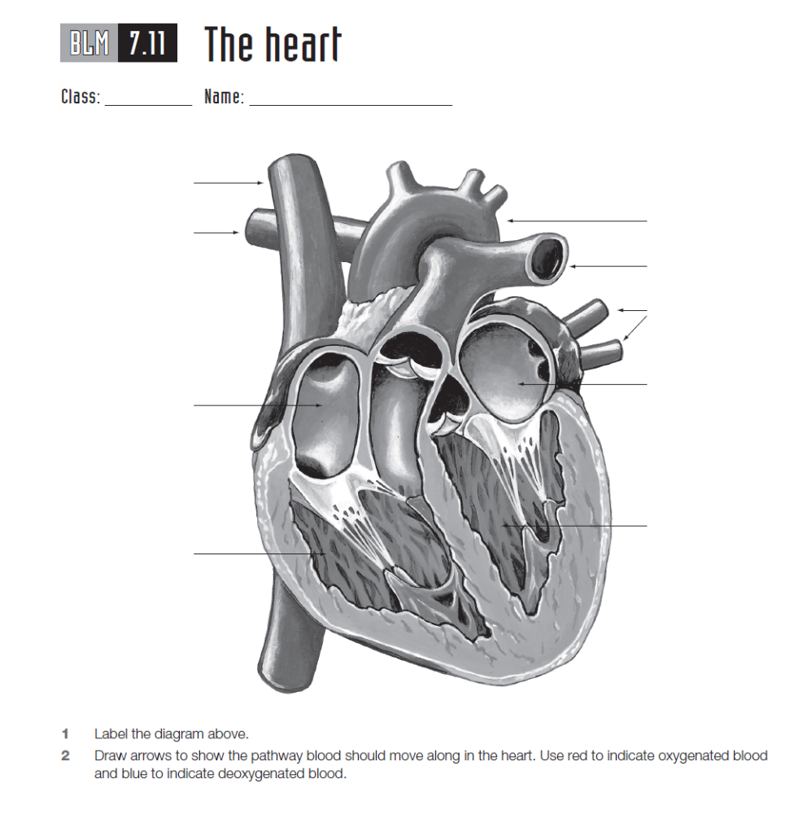
Label the heart diagram on your sheet including the chambers and blood vessels
Add the flow of the blood on your diagram using red(high O₂) and blue (low O₂) arrows

Slide 6
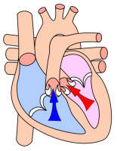
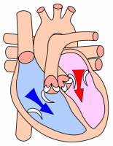
Explain how the blood flows through the heart.

Slide 7
Oxygen rich blood enters the heart from the lungs into the left atrium and pumps it to the left ventricle through the mitral valve. The left ventricle pumps the oxygen-rich blood through the aortic valve out to the rest of the body.
The right atrium receives the oxygen-poor blood from the body through pulmonary valve to the right ventricle to be pumped to the lungs.

Slide 8
Objective
Understand function the blood vessels in the circulatory system.

Slide 9
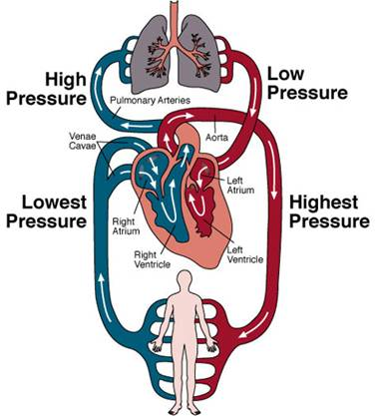
Blood
Flow
Around the
Body
Lungs
Pulmonary vein
Body

Slide 10
Main Vessels in the Circulatory System
Vessel | Structure of vessel wall | Function
Artery | Thick-walled and muscular | Carry blood to organs
Capillary | Very thin walls, only 1 cell thick | Allows materials to pass from blood to cells and cells to blood.
Vein | Thin-walled with valves | Carry blood back to the heart.

Slide 11
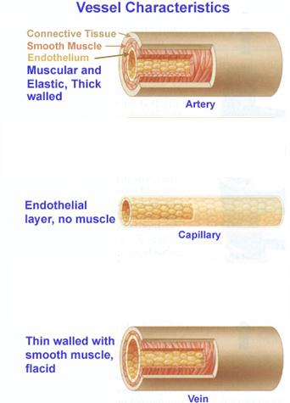
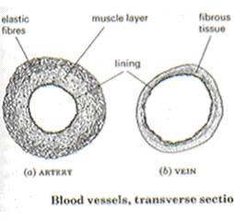
Cross Sections

Slide 12
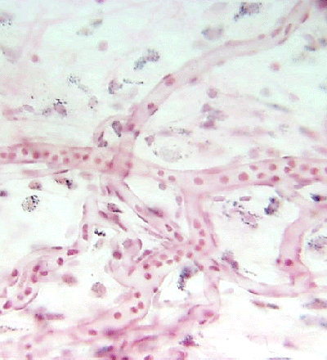
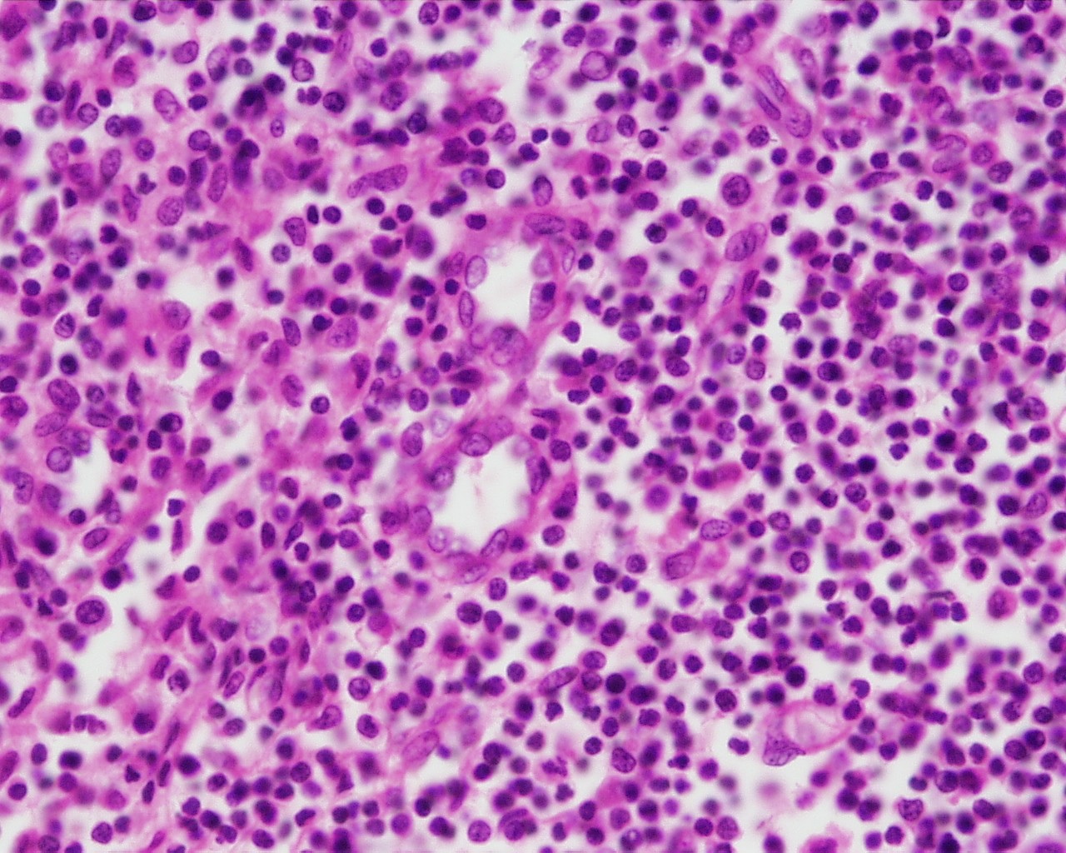
Capillaries
Capillary
G. Meyer – ANHB, UWA
L. Slomianka – ANHB, UWA

Slide 13
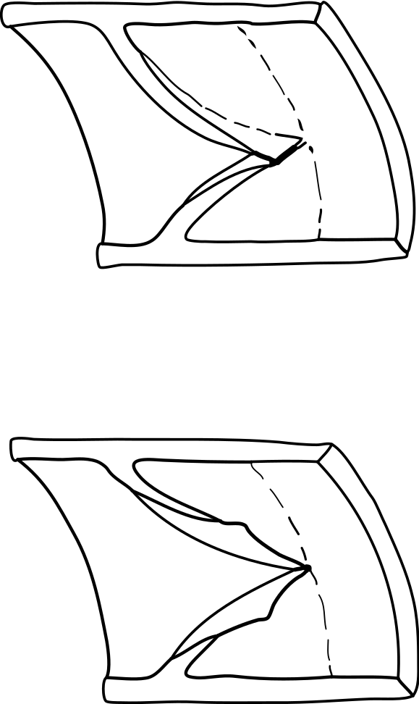
Veins contain valves to prevent the back flow of blood
Valve open
Valve closed

Slide 14
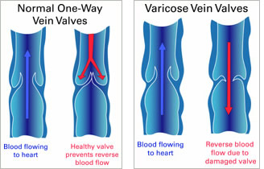

Slide 15
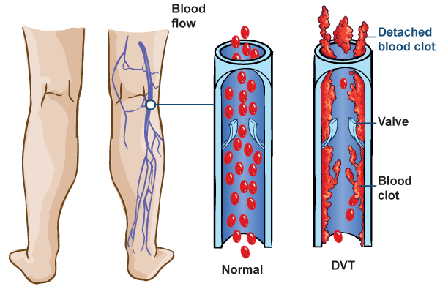

Slide 16
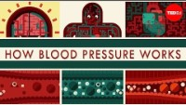

Slide 17
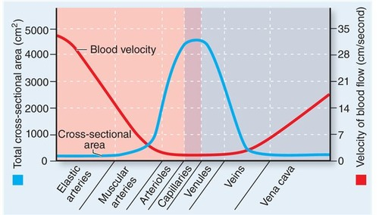

Slide 18
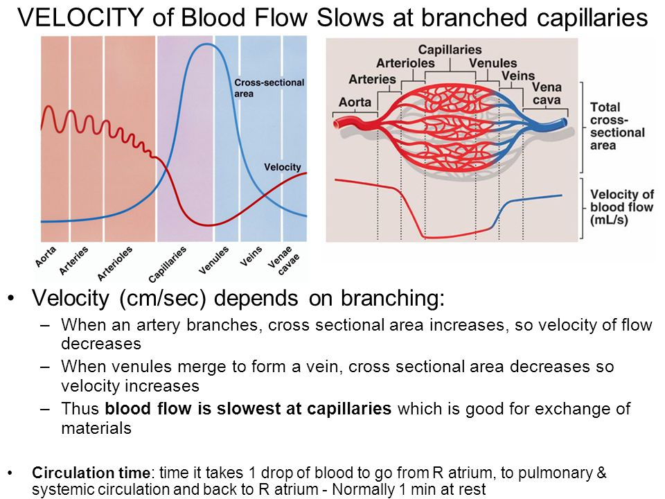

Slide 19
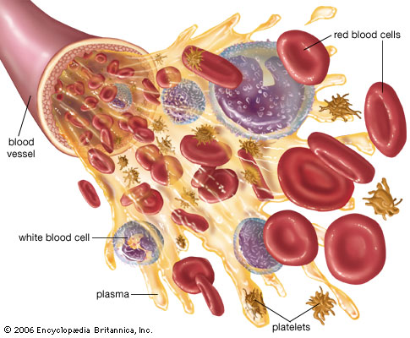
Blood Cells

Slide 20
Blood is made up of plasma and blood cells, each with particular function aids in the:
transport of materials, including oxygen, nutrients and waste
defence against pathogens

Slide 21
The Main Components of Blood
Component | Function
Plasma (55%) | Transport of: Oxygen Digested food Carbon dioxide Wastes Hormones Salts Heat
Blood Cells (45%) Red blood cells White blood cells Platelets | Carry oxygen Protect the body Clotting of the blood

Slide 22
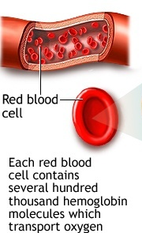
Red Blood cell
Life Span = 120 days
No Nucleus present to save space for carrying oxygen & to go through narrow spaces and capillaries.
Haemoglobin is present to attach to oxygen.

Slide 23
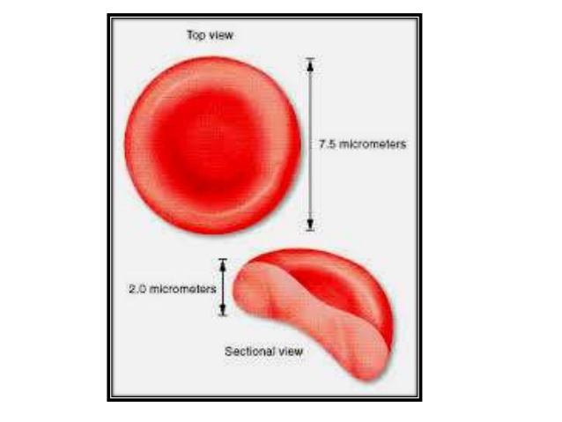

Slide 24
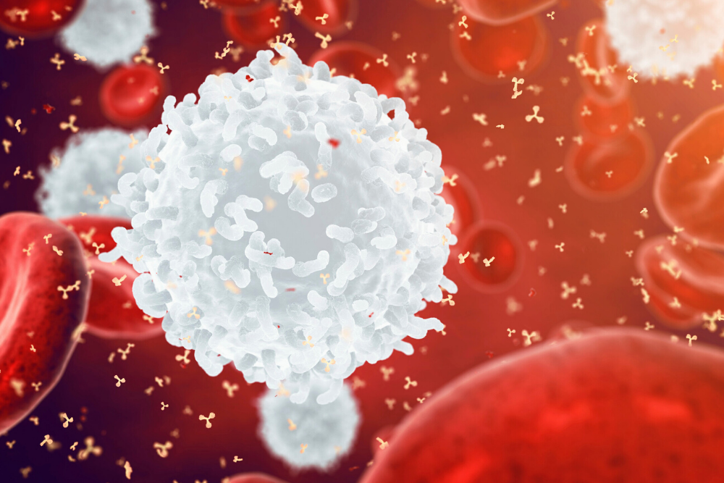
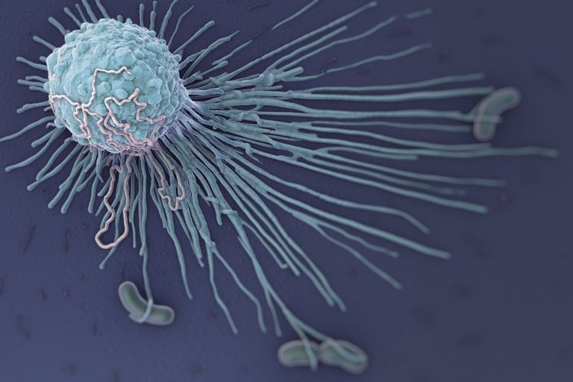
White Blood Cells
Fights infections and foreign substances by engulfing and destroying them (phagocytosis).
Shape varies so that they can squeeze between cells in the tissues.

Slide 25
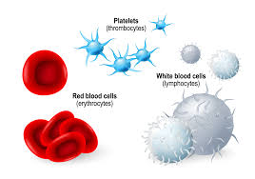
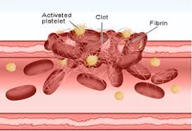
Platelets
Irregular shape to help in clotting blood to stop bleeding.

Slide 26
Disease of the circulatory system
Hypertension
Arteriosclerosis
Angina
Heart attack
Stroke
Peripheral vascular disease

Slide 27
Functioning Body Systems
How does the circulatory system work with other body systems?

Slide 28
Answer:
The circulatory system works with the respiratory system to provide oxygen to cells;
It works with the urinary and digestive systems to remove waste products;
It helps give skin colour;
It is under control of the nervous system.

